Slide 1
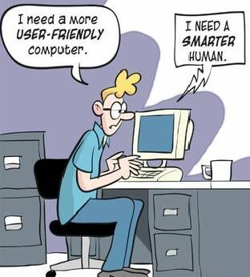

COMP S266F Computer Architecture Chapter 0. Course Overview

Slide 2
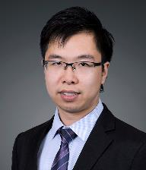
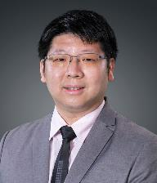
The Teaching Team
Course Coordinator : Dr. John Chui
Email : jktchui@hkmu.edu.hk
Phone : 2768 6883
Room: A0920
Tutor : Mr. Tommy Kwok
Email : cpkwok@hkmu.edu.hk
Phone : 2768 6820
Room: A0923
2

Slide 3
Course Information
Online Learning Environment (OLE)
https://ole.hkmu.edu.hk
Use your student ID and password to login
Release materials including lecture notes, slides, etc.
Tutorial exercise will be released and completed online
* Course announcements via E-mail
3

Slide 4
Course Aim
This course aims to develop student knowledge in the design of modern programmable computers and the major components.
4

Slide 5
Learning Outcomes
Upon completion of this course, students should be able to:
Explain data representations in computer systems
Explain and analyse general hardware architectural designs of computer systems
Describe the basic operations of processor, memory, instruction execution, and input/output based on an abstraction of a programmable computer
Compare and contrast the various design and implementation approaches to hardware architecture
5

Slide 6

Textbook/Reference Book (Optional)
Irv Englander (Feb. 2014). The Architecture of Computer Hardware, Systems Software & Networking – An Information Technology Approach (5th edition), Wiley. ISBN: 978-1-118-32263-5
6

Slide 7
Assessment
Continuous Assessment (30%)
Quizzes (25%)
Lab test (5%)
Must pass
Exam (70%)
2-hour On-campus examination
Must pass
Passing Marks : at least 40 in both Continuous Assessment and Exam
7

Slide 8
Continuous Assessment
Quizzes (25%)
Start of lectures in designated weeks
11:05 a.m. 20 Oct 2021 (Week 5)
11:05 a.m. 10 Nov 2021 (Week 8)
11:05 a.m. 24 Nov 2021 (Week 10)
11:05 a.m. 15 Dec 2021 (Week 13)
4 Multiple Choice Quizzes
10 MC questions
20 minutes each
Rules of examination applied
8

Slide 9
Continuous Assessment
Lab Test (5%)
LMC Programming Test
2 Questions
90 minutes
2-4 p.m. 16 Nov 2021 (P03) (Week 9)
4-6 p.m. 16 Nov 2021 (P04) (Week 9)
2-4 p.m. 18 Nov 2021 (P01) (Week 9)
4-6 p.m. 18 Nov 2021 (P02) (Week 9)
9

Slide 10
Computer Architecture
Chapter 0: Course Overview (Week 2)
Chapter 1: Programmable Computers (Week 2)
Chapter 2: Arithmetic and Logic Unit Design: Data Representation (Week 3)
Chapter 3: Arithmetic and Logic Unit Design: Floating Point Operations (Week 4)
Chapter 4: Basic Programmable Computer Design: From ALU to CPU (Week 5)
Chapter 5: Case Study: Little Man's Computer (Week 6-7)
Chapter 6: Technologies of Computer Components (Week 8-9)
Chapter 7: Case Studies on Performance Improvement Features (Week 10)
Chapter 8: Instruction Set Architecture and Addressing Modes (Week 11-12)
Chapter 9: Architectures for High Performance Computing (Week 13)
Revision and Highlights: Upload as supplementary video via OLE
https://www.hkmu.edu.hk/undergraduate-students/policies-and-guidelines/academic-calendar/
10

Slide 11
Little remarks that you should know
HKMU Accounts
Teaching Mode (Special Arrangement in 2021 Autumn Term)
Plagiarism Checking System
11

Slide 12
HKMU Accounts
HKMU basic account :
Receive mails from HKMU and faculty staffs
Download software provided by HKMU
HKMU Google account :
Apply services from Google
Microsoft O365 account
Apply Microsoft O365 services.
12

Slide 13
Activate HKMU Accounts
HKMU basic account : https://secureweb.hkmu.edu.hk/password/~itu/HKMU/STUDENT/act_passwd.pl
Login : “s” + first 7 digits of SID + “@hkmu.edu.hk”
You need to create a single password to login this account.
Google account : http://mail.google.com/a/study.hkmu.edu.hk
Login : “g” + first 7 digits of SID + “@study.hkmu.edu.hk”
Microsoft (O365) account : http://www.outlook.com/live.hkmu.edu.hk
Login : “a” + first 7 digits of SID + “@live.hkmu.edu.hk”
Initial Password for Google and Microsoft accounts :
https://student.intranet.hkmu.edu.hk/hkmu_gmail/
https://student.intranet.hkmu.edu.hk/hkmu_o365/
13

Slide 14
Activate HKMU mail Accounts
For LOCAL students
For NON-LOCAL students
SID : 13141516
HKID : S876543(A)
Date of Birth : 26 March 2001
Login Name : s1314151@hkmu.edu.hk g1314151@study.hkmu.edu.hk a1314151@live.hkmu.edu.hk
Initial Password HKmu543A2603
SID : 13141516
Passport No. : BB9897969594910
Date of Birth : 26 March 2001
Login Name : s1314151@hkmu.edu.hk g1314151@study.hkmu.edu.hk a1314151@live.hkmu.edu.hk
Initial Password HKmu49102603
14

Slide 15
Tutorials
You should complete all tutorial exercise which are important to your quizzes and examination.
Tutor will discuss with classmates about the questions.
Answers will be released in the class.
15

Slide 16
Teaching Modes in 2021 Autumn Term
The latest Teaching and Learning Arrangements for 2021 Autumn Term
Lectures
Face-to-face mode
Recordings will be made available online (via OLE) for students who have successfully applied and received approval for online learning
Tutorials
Face-to-face mode
Recordings will be made available online (via OLE) for students who have successfully applied and received approval for online learning
Quiz
Mode to be confirmed
Exam
Face-to-face mode
16

